Slide 1
Sensitivity Analysis

Slide 2
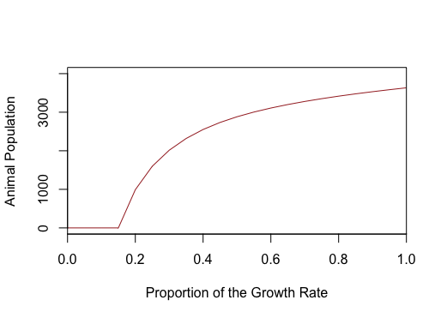
Growth rate vs animal population

Slide 3
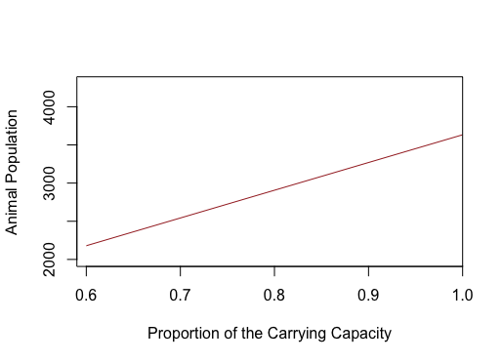
Carrying capacity vs animal population

Slide 4
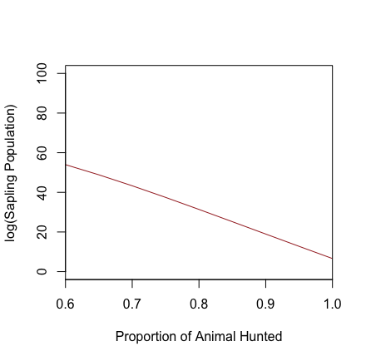
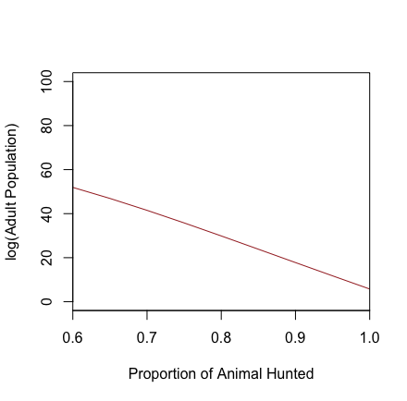

Plant abundance (under high hunting)

Slide 5
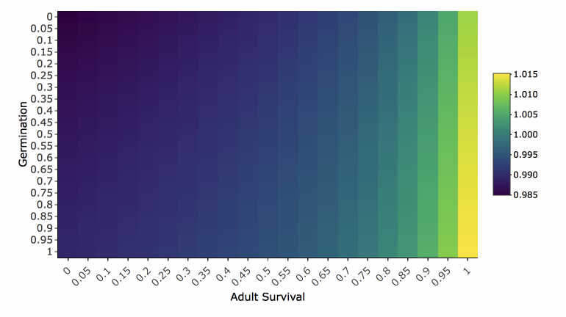
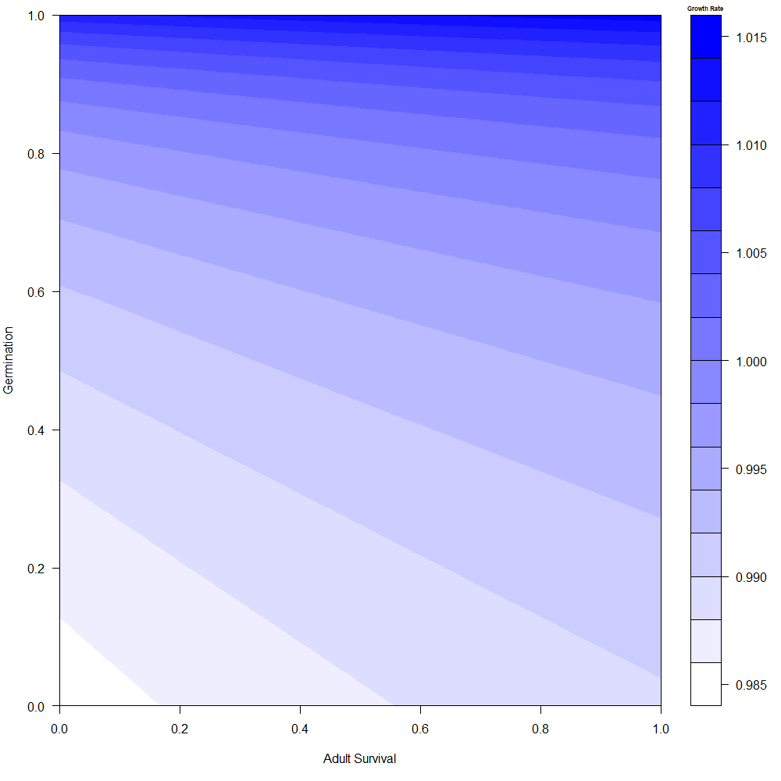
Adult plant survival vs Germination

Slide 6
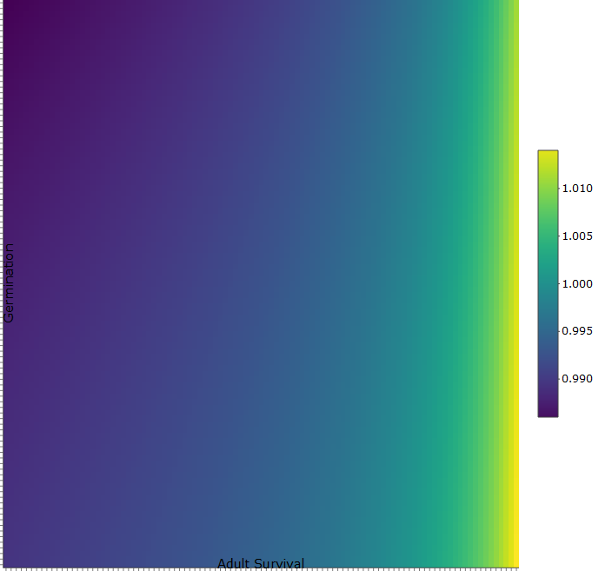
Continued

Slide 7
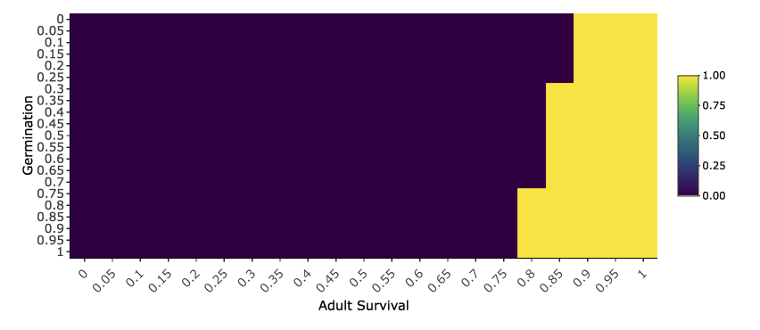
Binary heatmap

Slide 8
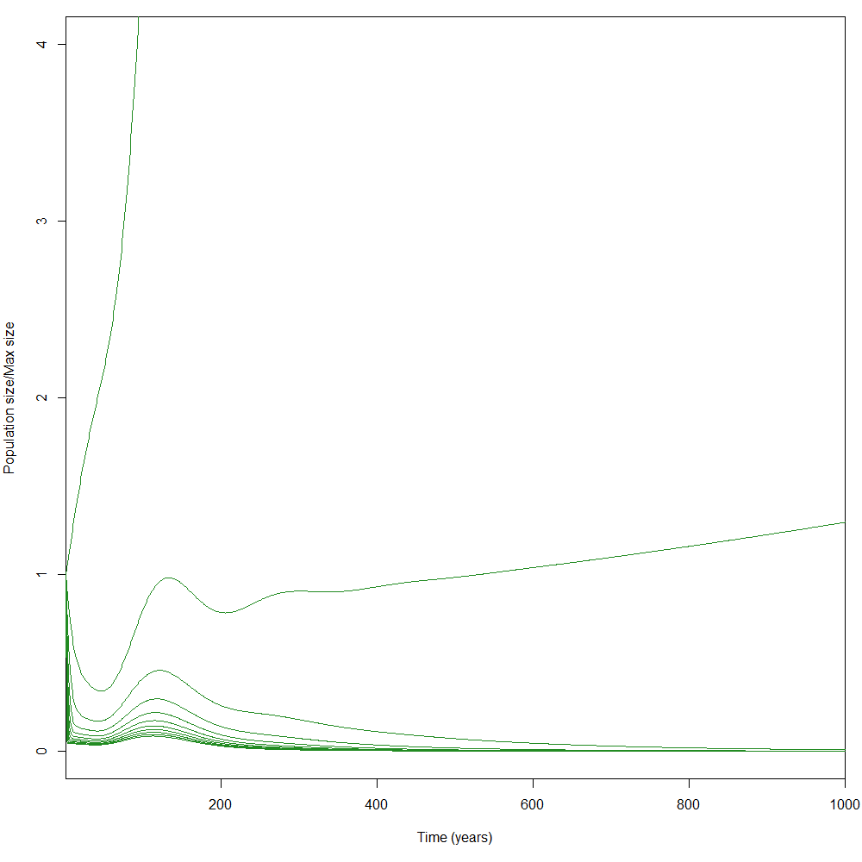
Harvest Survival Probability (under purely high harv)

Slide 9
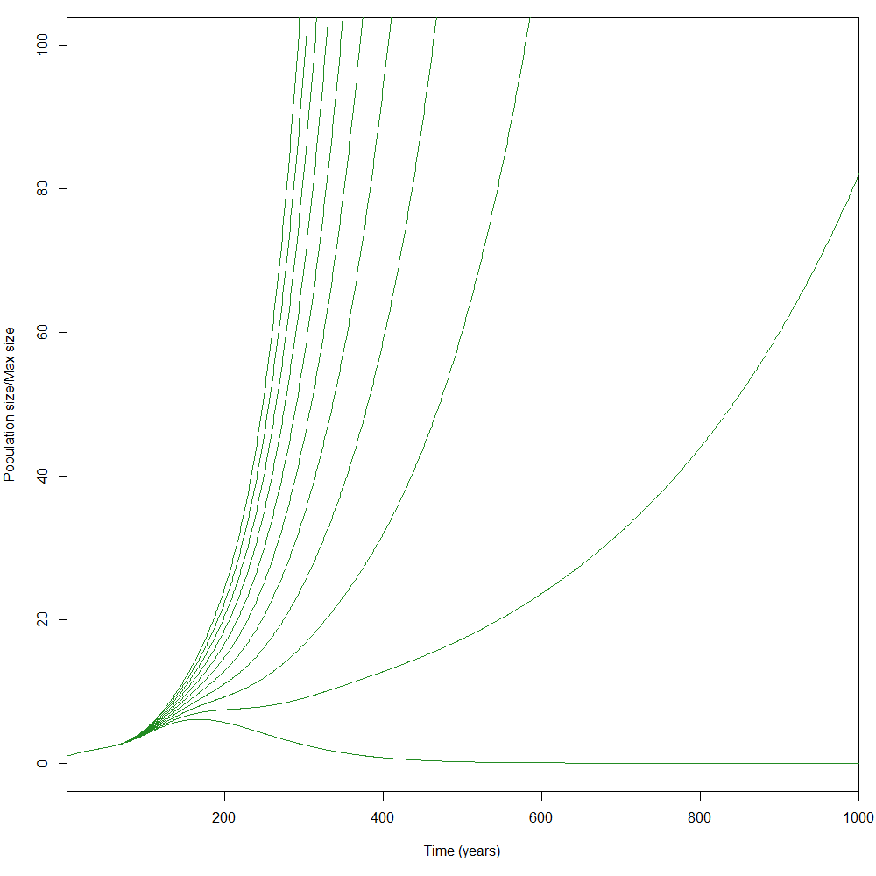
Percent Harvested (Germination) (under purely high harvest)

Slide 10
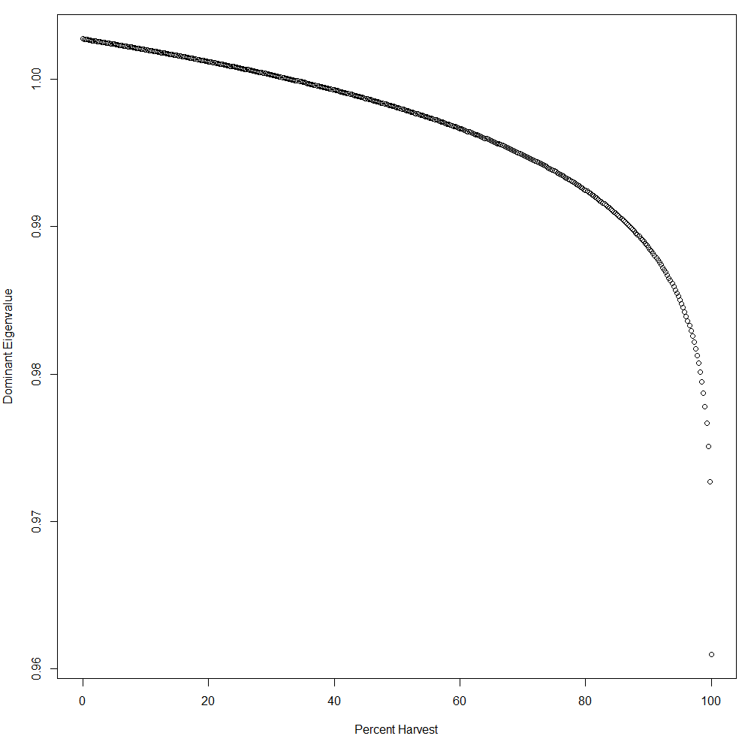
Eigenvalues vs. Percent Harvest

Slide 11
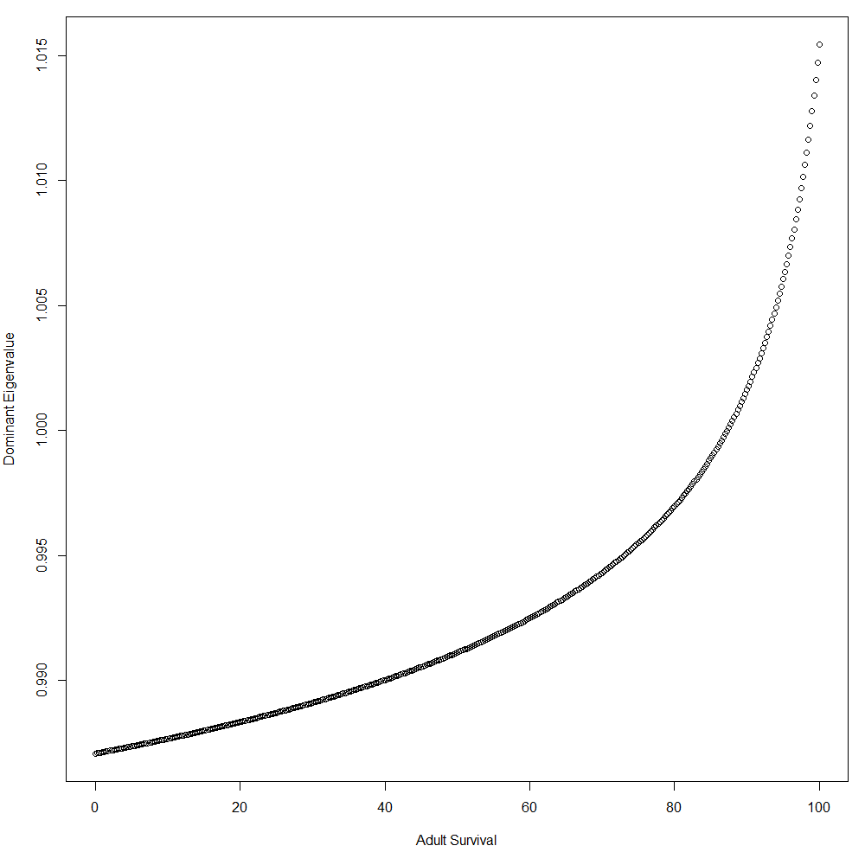
Eigenvalues vs. Adult Survival

Slide 12
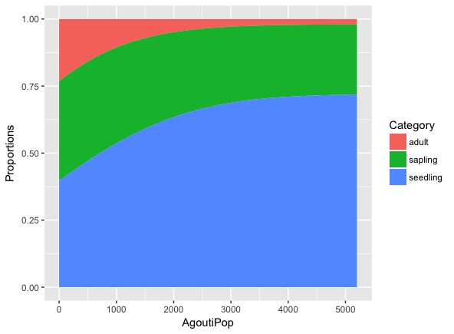
Right eigenvector vs Agouti population (low Harvest)

